Slide 1
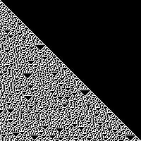
Controlling Cellular Automata
Hannah Dromiack
Mentors: Sara I. Walker, Douglas G. Moore

Slide 2
What are Cellular Automata?
A Cellular Automaton (CA) is a collection of "colored" cells on a grid of specified shape. The cells evolve through a discrete number of time steps according to a set of rules based on nearest-neighbor interactions.
Notes:
How they do this is by looking at their direct neighbors and determine their next state based on the rule.1D CA have 256 rules that can be used.

Slide 3
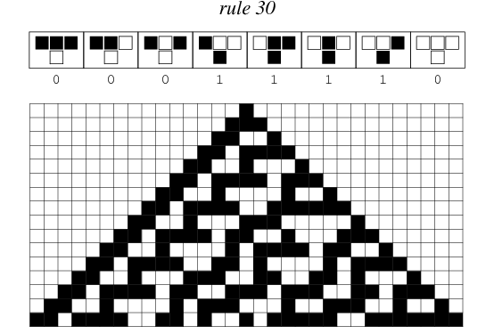
t = 0

Slide 4
t = 1

Slide 5
t = 2

Slide 6
t = 15
Image provided be Wolfram [3]

Slide 7
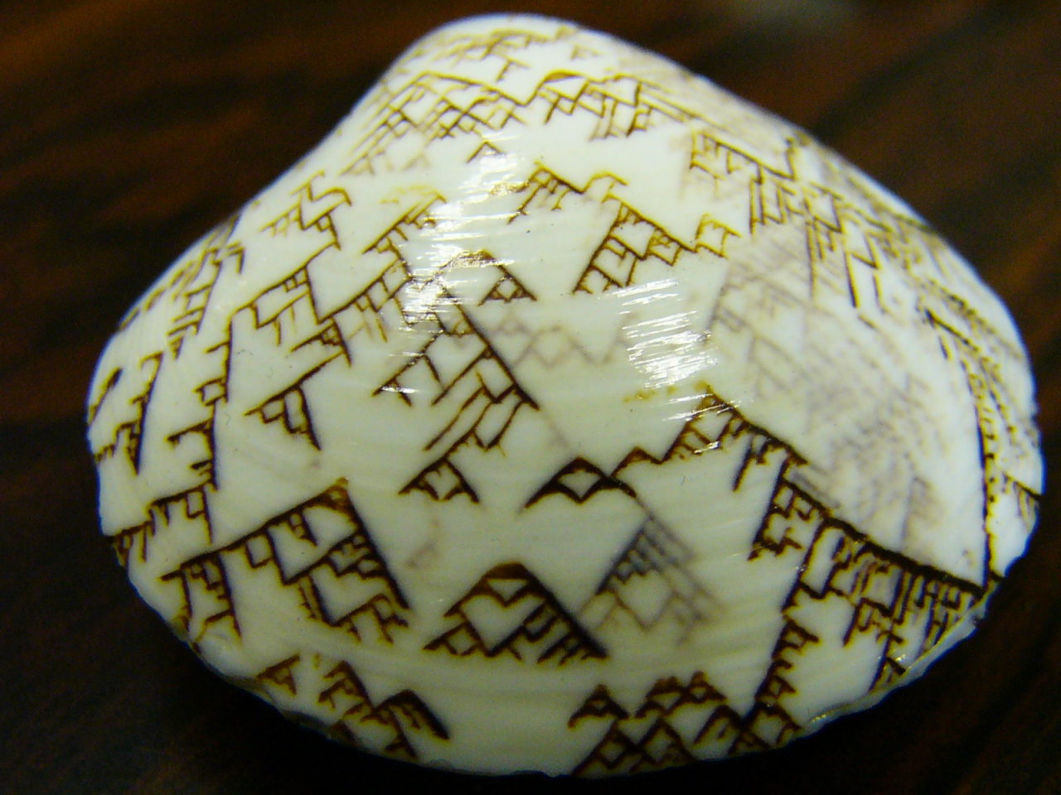
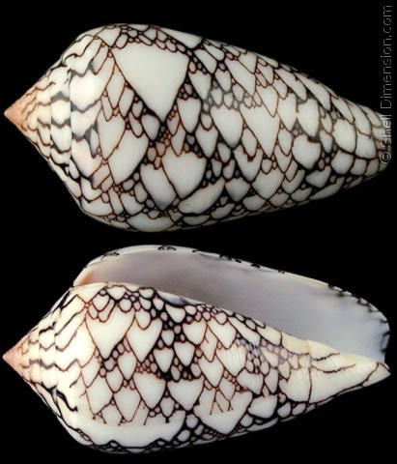
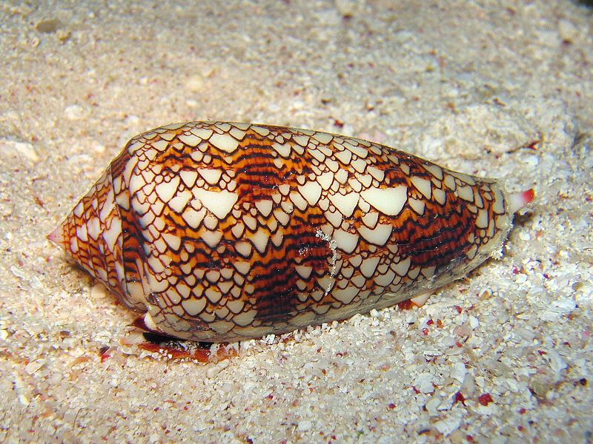
Seen in Nature
[2]
[3]
[2]

Slide 8
Code Outline
Input: Initial – [1,0,1,1,0,0,1,1]
Final – [0,0,1,0,1,1,0,1]
Function: where_to_go(initial, final):
Output: [[22, 23, 150, 151],
[73, 105, 201, 233]]

Slide 9
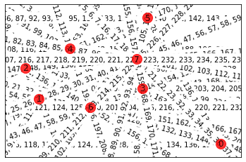
Contribution to Modern Art

Slide 10
References
[1] https://mathworld.wolfram.com/Rule30.html
[2] http://rebloggy.com/post/naturally-occurring-sea-shell-patterns-similar-to-those-generated-by-cellular-au/99807772952
[3] http://eusa-riddled.blogspot.com/2015_06_07_archive.html

